Slide 1
BBOX INBOUND
PROCEDURAL
FLOW
1

Slide 2
DEFINITION
1. WHAT ARE “BALIKBAYAN BOXES”?
Balikbayan Boxes are packages of PERSONAL EFFECTS and/or “PASALUBONGS” sent by Filipinos residing or working abroad to their families or relatives in the Philippines to enhance Philippine tradition and culture for the promotion and preservation of strong family ties through love and caring expressed in gift-giving.
2. WHAT ARE ALLOWED IN “BALIKBAYAN BOXES”?
Non-commercial goods or goods not in commercial quantity strictly for personal use only (12 pcs or less of said commodities), such as: wearing apparel, clothing, foodstuffs/grocery items/canned goods; the value of which must not exceed US$200.00 (Php 10,000.00).
(Note that by rule, point 2 is technically on a per consolidation basis following the procedure consolidators practice but are just arranged with Customs)

Slide 3
DEFINITION
Though we are lenient on the "pasalubongs" definition, we would like to stress on the limits set by Customs, specifically:
Non-commercial goods or not in commercial quantity (at most 12 pcs of each kind). This pertain to "Personal Effect" items such as used clothes and foodstuff/grocery items/canned goods.
2. Must not exceed the individual value threshold of USD 200.00 / PHP 10,000.00
- based on OR/receipts and even internet value
If the Origin team receives inquiries outside of these limits (more than 12 pcs. and/or above Php10,000.00) and NOT INCLUDED on the arranged TAX TABLE, IT IS A MUST to get approval first from the PH Team before formal acceptance to ensure no interruption in the Customs Clearance process. Note that Philippine Customs have heightened x-ray and assessment activities.

Slide 4
Prohibited Importation Guide
Prohibited Importation:
Written or printed goods in any form containing any matter advocating or inciting treason, rebellion, insurrection, sedition against the government of the Philippines, or written or printed goods containing any threat to the life of, inflict bodily harm upon any person in the Philippines;
Goods, instruments, drugs and substances designed, intended or adapted for producing unlawful abortion, or any printed matter which advertises, describes or gives direct or indirect information where, how or by whom unlawful abortion is committed;
Written or printed goods negatives or cinematographic films, photographs, engravings, lithographs, objects, paintings, drawings or other representation of an obscene or immoral character;
Any goods manufactured in whole or in part of gold, silver or other precious metals or alloys and the stamp, brand or mark does not indicate the actual fineness of quality of the metals or alloy;
Any adulterated or misbranded food or goods for human consumption or any adulterated or misbranded drug in violation of relevant laws and regulations;
Infringing goods as defined under the Intellectual Property Code and related laws; and
All other goods or parts thereof which importation are explicitly prohibited by law or rules and regulations issued by the competent authority

Slide 5
Regulated Importation Guide
Regulated Importation :
Goods which are subject to regulation shall be imported only after securing the necessary goods declaration, clearances, licenses and any other requirements, prior to importation. In case of importation, submission of requirements after arrival of the goods but prior release from customs custody shall be allowed but only in cases provided for by the governing laws or regulations
Example of which are:
Food products, cosmetics which require permit from the FDA (see exemptions on later pages)
Aquatic products – permit from Bureau of Fisheries and Aquatic Resources

Slide 6
Restricted Importation Guide
Restricted Importation:
Except when authorized by law or regulation, the importation of the following restricted goods are prohibited:
Dynamite, gunpowder, ammunitions and other explosives, firearms and weapons of war, or parts thereof;
Roulette wheels, gambling outfits, loaded dice, marked cards, machines, apparatus or mechanical devices used in gambling or the distribution of money, cigars, cigarettes or other goods when such distribution is dependent on chance, including jackpot and pinball machines or similar contrivances, or parts thereof
Lottery and sweepstakes tickets, except advertisements thereof and lists of drawing therein
Marijuana, opium, poppies, caca leaves, heroin or other narcotics or synthetic drugs which are or may hereafter be declared habit forming by the President of the Philippines, or any compound, manufactured salt, derivative, or preparation thereof, except when imported by the government of the Philippines or any person duly authorized by the Dangerous Drugs Board, for medicinal purposes;
Opium pipes or parts thereof, of whatever material; and
Any goods whose importation are restricted
The restriction to import the above stated goods shall include the restriction on their transit

Slide 7
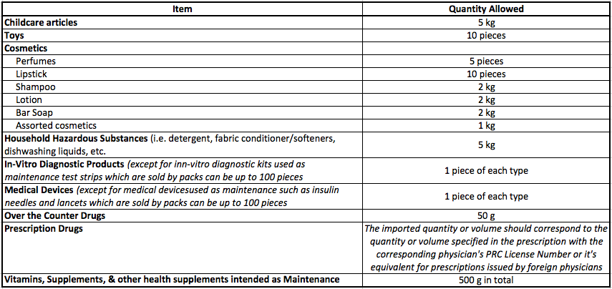
Summary : Importation of FDA-DOH Regulated Products for PERSONAL
Imports of FDA-DOH – regulated products as listed below maybe brought into the Philippines without prior clearance from the FDA, provided such products are:
For Personal Use;
In quantities not exceeding the limits shown below; and:
Brought into the Philippines in any of the following ways:
In passenger baggage, whether accompanied or unaccompanied
In balikbayan boxes; or
In parcels sent through mail or delivery services
The FDA-DOH regulated products and quantities are as follows:

Slide 8
Summary : Importation of FDA-DOH Regulated Products for PERSONAL
The limits apply to the totality of all products within a specific category (i.e. childcare articles, toys, cosmetics, etc. ). For example:
Any quantity of the covered products, whether declared or undeclared, beyond the specific limits which does not have the required FDA-DOH clearance, will be seized and forfeited in the favor of the government. Those within the specific limit shall be allowed without the FDA-DOH clearance subject to payment of customs duties, when necessary.
Fresh or frozen unprocessed foods-including fresh fruits, frozen meat, fresh fish- even in quantities for personal use, may not be brought into, or sent to, the Philippines without prior clearance from the relevant agency of the Department of Agriculture.
Importation of any household urban pesticides shall require prior FDA clearance.
All dangerous drugs, controlled precursors and essential chemicals, and other similar or analogous substances are subject to the regulations of the Dangerous Drugs Board (DDB) and the Philippine Drug Enforcement Agency (PDEA)

Slide 9
SHIPMENT ACCEPTANCE
CLIENT AT ORIGIN
Origin receives client in branch
Origin checks item/s if acceptable and within BB parameters in terms of COMMODITY, QUANTITY and VALUE.
Max of 12 units of same item
Max of USD 200.00 (Php 10,000.00) total value
Must satisfy ALL parameters (eq. 2 items only but more than USD 200.00 is not acceptable)
If in TAX TABLE, it should be acceptable
Shipment must have a unique shipper and consignee specially for clients with multiple shipments
Anything beyond the BB limit will be subject to approval first with PH team as it may be for Tax assessment
Origin to ensure shipment details are captured in the Packing List (correct qty /value/ commodity) and in the system
Continue with acceptance of shipments until cutoff
*Computation of taxes will be based on VALUE from either the:
- Receipted value
- Suggested Retail Price
- Or Internet Value
WHICHEVER IS HIGHER

Slide 10
END OF PROCESS

